Slide 1
Understanding poetry
B.A Third Year
Semister 5,2019-20

Slide 2
Types of Elizabethan poetry
Elizabethan Period
1558 starts
1603 Ends. Golden Period

Slide 3
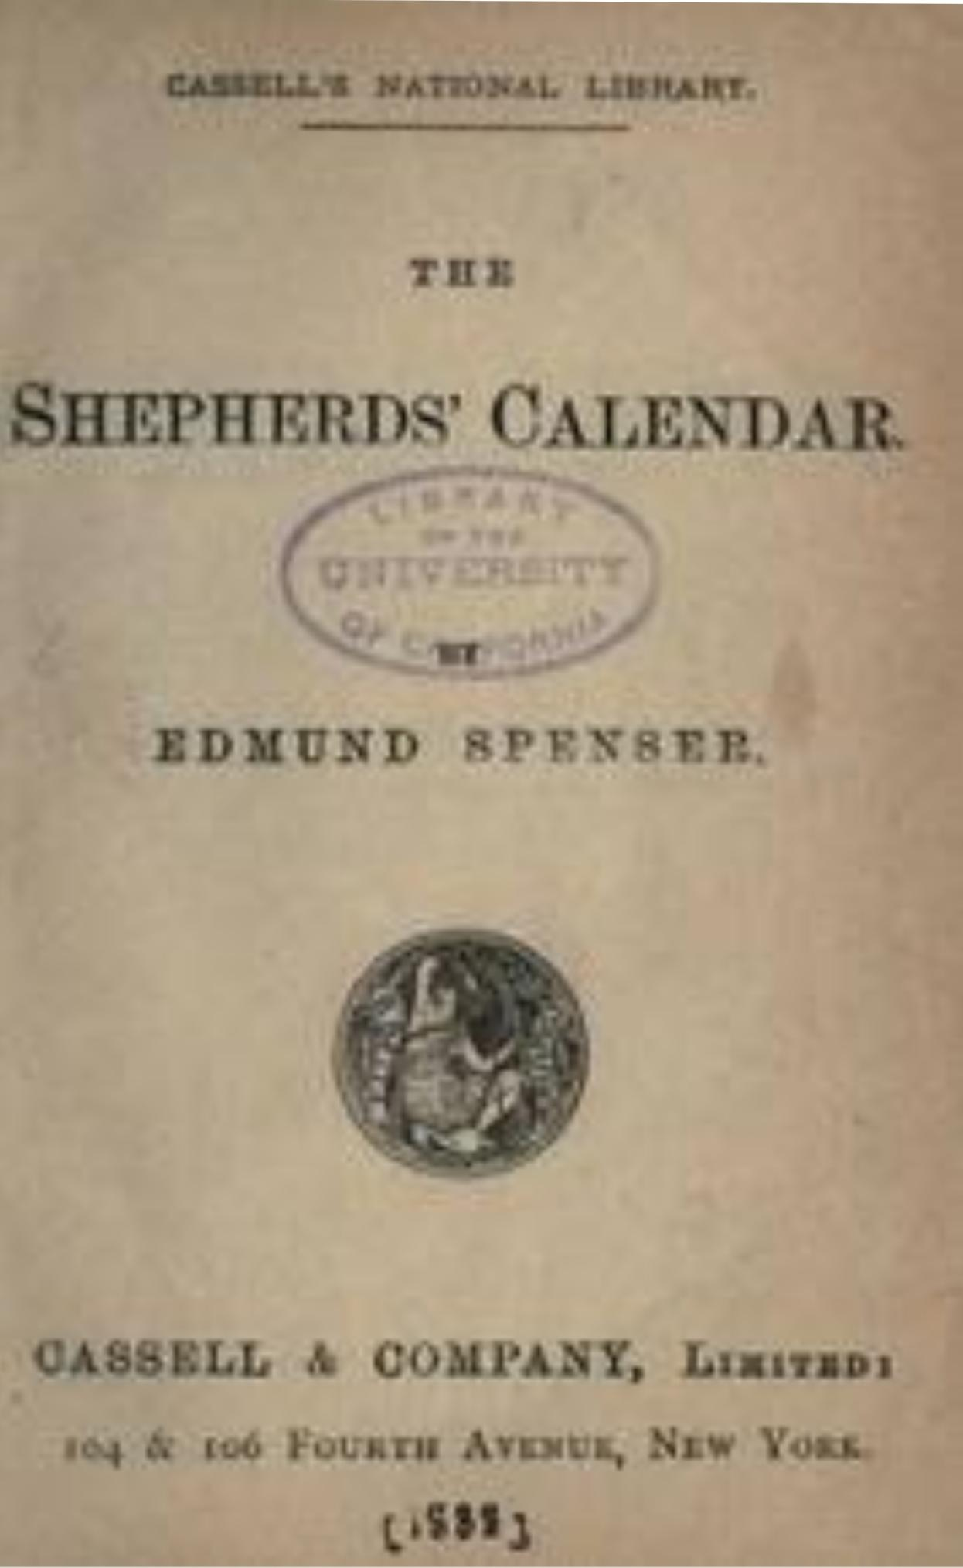
Shepherd’s Calendar
Published in the year 1579 – beginning of proper Elizabethan age

Slide 4
Elizabethan Lyric
It is the glory of the age,sweet songs were written and published during this age
So this age is called as ‘The Nest of singing Birds’
Love was the main theme of lyric.
One of the finest lyricists of the age was Sir Philip Sidney.
His famous book – ‘Astrophell and Stella’

Slide 5
Elizabethan sonnet
It made the Elizabethan poetry rich and vivid
It was emerged in Italy bye Petrarch
Wyatt and Surrey brought it into England
In the beginning it was written in Iambic Pentamitter
Shakespeare made some changes in petrarchians method.

Slide 6
ELIZABETHAN SONGS
Song became popular in this age
The court of Elizabeth is called as nest of singing Birds’
Shakespeare wrote many songs for his play
This age witnessed many types of songs:love songs, religious songs, patriotic songs,war songs and philosophical songs.

Slide 7
Pastoral poetry
It is a form of elegy
It is also called as pastoral elegy
In this form poet is expected to speak as shepherd
He weeps with the death of his fellow Shephard
Sheep, shepherd, flowers,rural life this images used by poet.

